Slide 1
Unit 3 Computer Memory

Slide 2
Syllabus
Introduction
Memory Hierarchy
CPU Registers
Cache Memory
Primary Memory
Secondary Memory (Introduction)
Types of Secondary Memory
How the Computer uses its memory?

Slide 3
Introduction
Computer memory is the storage space in the computer, where data is to be processed and instructions required for processing and data for future retrieval are stored.
Memory Representation
Memory unit is the amount of data that can be stored in the storage unit. This storage capacity is expressed in terms of Bytes.
The main memory storage units are:
Bit (Binary Digit): A bit is a single binary digit, i.e., 0 or 1. A bit is the smallest unit of representation of data in a computer.
Nibble: A group of 4 bits is called nibble.
Byte: A group of 8 bits is called byte. A byte is the smallest unit, which can represent a data item or a character.
Word: A group of bytes can be further combined to form a word. A word can be a group of 2, 4 or 8 bytes.
1 bit = 0 or 1
1 Byte (B) = 8 bits
1 Kilobyte (KB) = 1024 Bytes
1 Megabyte (MB) = 1024KB
1 Gigabyte (GB) =1024 MB
1 Terabyte (TB) =1024 GB

Slide 4
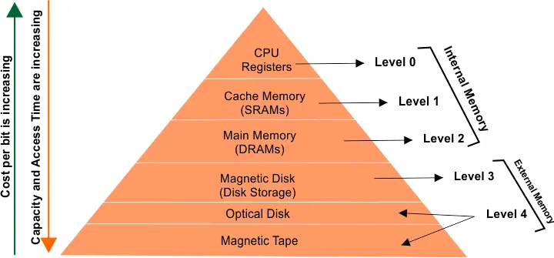
Memory Hierarchy

Slide 5
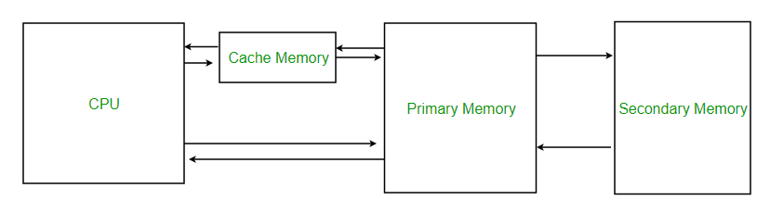
Cache Memory
It is high speed memory locations that resides between CPU and RAM.
Speed of CPU is always higher than primary memory(RAM)
Therefore, performance of CPU decreases due to slow speed of main memory.
To compensate this delay small chip is established between CPU and RAM
It store the data and instruction that the CPU is likely to required next

Slide 6
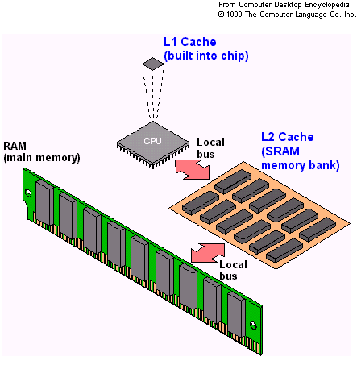
Cache Memory
Cache Hit: When CPU needs data, it searches in the cache memory first. If the data is found in Cache memory, it is said to be cache hit.
Cache Miss: If the data is found in cache memory and have to search into primary memory, it is said to cache miss
Commonly appeared levels of Cache memory
L1 Cache: (internal or primary cache). It is build in processor chip. It is smallest, fastest and most expensive cache memory.
L2 Cache: (external cache). It is build on motherboard separate from processor chip. It is slower than L1 cache.

Slide 7
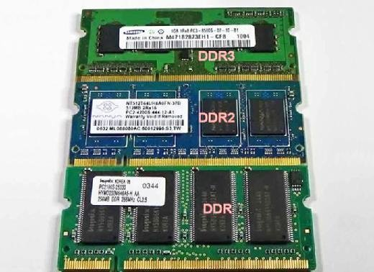
Primary Memory
It is directly accessible directly by the processing unit(CPU).
It stores the data and instructions that is required by the CPU during execution phase.
Types of Primary memory:
RAM: Random Access Memory
ROM: Read Only Memory

Slide 8
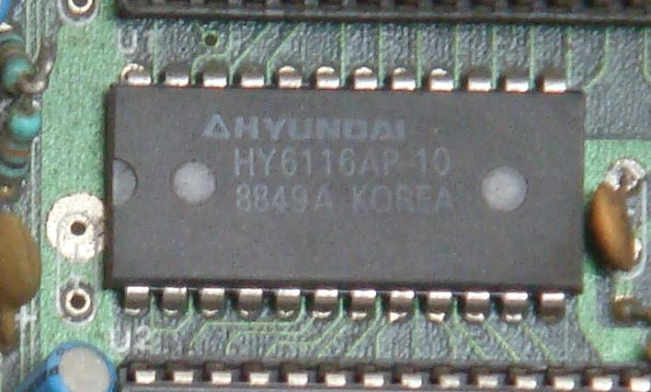
RAM
It is a volatile memory which stores the data to be processed in CPU and processed information before it is transferred to secondary memory or output device
Static RAM | Dynamic Ram
It is made up of transistors and flipflops | It is made up of Transistors and Capacitors
Six transistors are used to make a memory cell | One Transistor and one Capacitor is used to made a memory cell
It has no charge leakage property. So. It does not need to be refreshed | It has charge leakage property. So, it has to be refreshed many times
It requires less power | It requires more power
It is more expensive | It is less expensive
It is faster than DRAM | It is slower than DRAM
Data density of SRAM is lower and hence storage cost per bit is high | Data density of SRAM is higher and hence storage cost per bit is relatively low

Slide 9
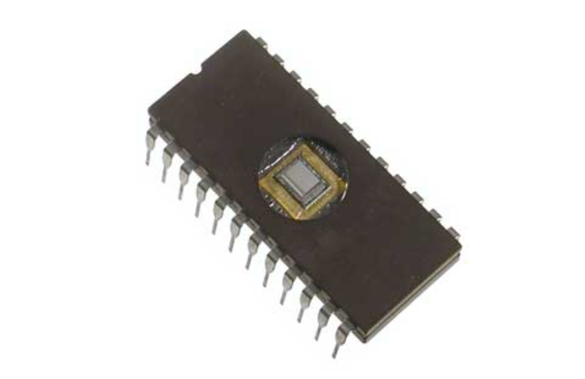
Read Only Memory(ROM)
ROM stands for Read Only Memory.
A ROM stores such instructions that are required to start a computer. This operation is referred to as bootstrap.
It is not volatile memory that means the data stored remains unchanged even if power gets cutoff
ROM chips are not only used in the computer but also in other electronic items like washing machine and microwave oven.

Slide 10
Types of Read-Only Memory (ROM)
PROM (Programmable read-only memory) – It can be programmed by the user. It is manufactured blank at first. Once programmed, the data and instructions in it cannot be changed.
EPROM (Erasable Programmable read-only memory) – It can be reprogrammed. To erase data from it, expose it to ultraviolet light. It takes around 15min to 20 min to erase the contents of ROM. To reprogram it, erase all the previous data.
EEPROM (Electrically erasable programmable read-only memory) – The data can be erased by applying an electric voltage, with no need for ultraviolet light. Hence, it is faster to erase. We can erase portions of the chip byte by byte
MROM(Mask ROM) – Mask ROM is a kind of read-only memory, that is masked off at the time of production. Like other types of ROM, mask ROM cannot enable the user to change the data stored in it. If it can, the process would be difficult or slow.

Slide 11
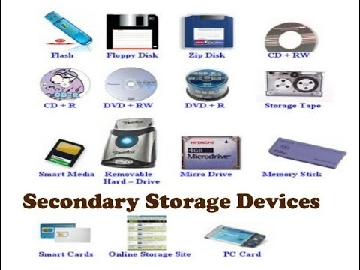
Secondary Memory/Auxiliary memory
Secondary memory is computer memory that is non-volatile and persistent in nature and is not directly accessed by a computer/processor.
It allows a user to store data that may be instantly and easily retrieved, transported and used by applications and services.
Secondary memory consists of all permanent or persistent storage devices, such as flash drives, hard disk drives (HDD), magnetic tapes and other types of internal/external storage media. In computing operations, secondary memory is accessed only by the primary or main memory and later transported to the processor.

Slide 12
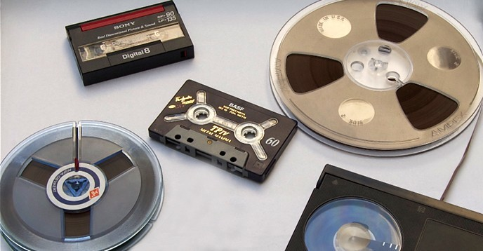
Magnetic Tape
Magnetic tape is a medium for magnetic storage made of a thin, magnetizable coating(iron oxide of ferric oxide) on a long, narrow strip of plastic film. It was developed in Germany in 1928, based on the earlier magnetic wire recording from Denmark. Devices that use magnetic tape could with relative ease record and playback audio, visual, and binary computer data.
It stores data in sequential order
Eg. VHS tape, Audio casseteetc

Slide 13
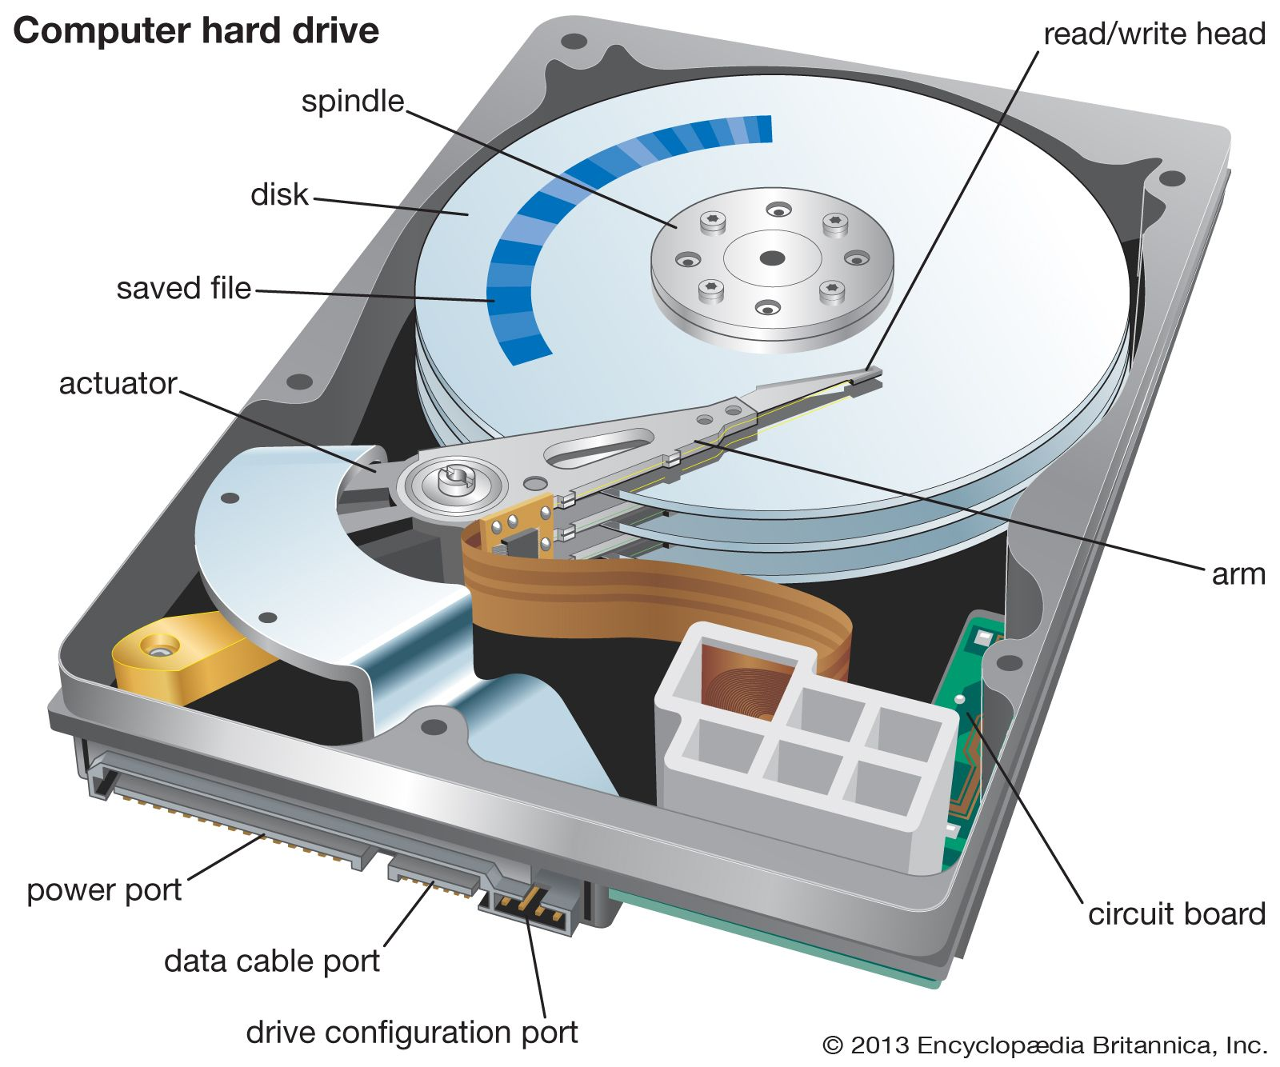
Magnetic Disk : Hard Disk
A hard disk drive (sometimes abbreviated as a hard drive, HD, or HDD) is a non-volatile data storage device.
It contains one or more platters, coated with magnetic material, housed inside of an air-sealed casing. Data is written to the platters using a magnetic head, which moves rapidly over them as they spin.
Data is written by magnetizing the area of hard disk.
Track
Sector

Slide 14
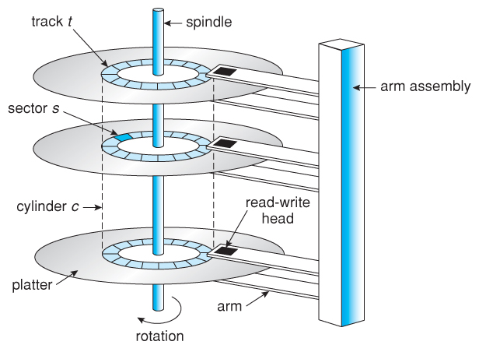
Mechanism of hard disk

Slide 15
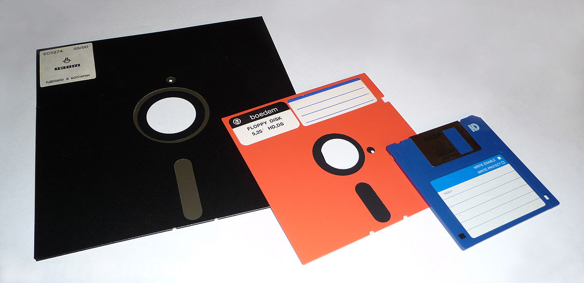
Floppy disk
A floppy disk is a type of storage media that reads data storage information, also known as a floppy diskette, floppy, or floppy disk that is used to store electronic data, like a computer file. It was extremely expensive at early times as it was one of the first types of hardware storage created in 1967 by IBM, which could read/write a portable device. The program could be able to install from one floppy disk if the program size was less than 1.44 MB

Slide 16
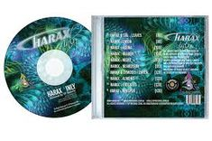
Compact Disk(CD)
CD stands for Compact Disk. CD is an optical storage device used in computers for the permanent storage of data and information.
CD makes use of laser light to read and write the data. Where the intended portion of the CD reflects the laser beam which is then detected by a photodetector. The most common variants of CD are – CD–ROM, CD-R (Recordable), and CD-RW (Re-Writable).
A standard compact disc measures 4.7 inches, or 120 millimeters (mm), across, is 1.2 mm thick, weighs between 15 grams and 20 grams, and has a capacity of 80 minutes of audio, or 650 megabytes (MB) to 700 MB of data.

Slide 17
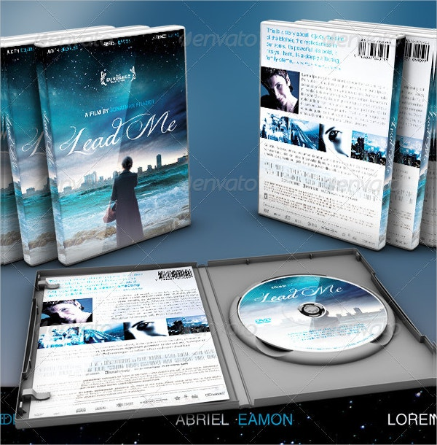
Digital Versatile Disk(DVD)
DVD stands for Digital Versatile Disk. It is also an optical storage device that is used as the secondary storage media in computers.
The construction and operation of DVDs are almost similar to that of CDs. The major difference is that a typical DVD can acquire about 7 times more amount of data as compared to a CD. DVD size ranges from 4.7 GB to 17 GB.
The main reasons behind the larger storage capacity of a DVD as compared to a CD are that the DVD provides dense packing of the data bits and uses a two-sided disc. Just like CD, DVD is also available in three common variants, i.e. DVD-ROM, DVD-R, and DVD-RW.

Slide 18
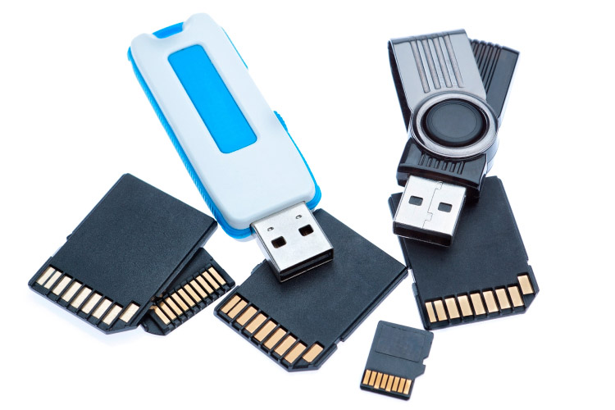
USB flash drive
A USB flash drive -- also known as a USB stick, USB thumb drive or pen drive -- is a plug-and-play portable storage device that uses flash memory and is lightweight enough to attach to a keychain. A USB flash drive can be used in place of a compact disc. When a user plugs the flash memory device into the USB port, the computer's operating system (OS) recognizes the device as a removable drive and assigns it a drive letter.

Slide 19
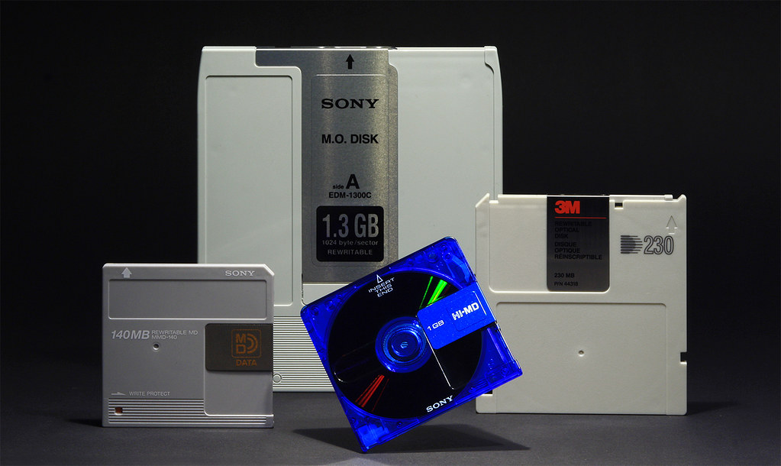
Magneto Optical Disk
Magneto-optical discs are a hybrid storage medium.
In reading, spots with different directions of magnetization give different polarization in the reflected light of a low-power laser beam.
In writing, every spot on the disk is first heated by a strong laser beam and then cooled under a magnetic field, magnetizing every spot in one direction, to store all 0 s. The writing process then reverses the direction of the magnetic field to store 1 s where desired.

Slide 20
How Computer uses its memory?
The computer starts using the memory from the moment the computer is switched on, till the time it is switched off. The list of steps that the computer performs from the time it is switched on are:
Turn the computer on.
The computer loads data from ROM. It makes sure that all the major components of the computer are functioning properly.
The computer loads the BIOS from ROM. The BIOS provides the most basic information about storage devices, boot sequence, security, plug and play capability and other items.
The computer loads the OS from the hard drive into the system’s RAM. CPU has immediate access to the OS as the critical parts of the OS are maintained in RAM as long as the computer is on. This enhances the performance and functionality of the overall system.
Now the system is ready for use.

Slide 21
How Computer uses its memory?
When you load or open an application it is loaded in the RAM. Since the CPU looks for information in the RAM, any data and instructions that are required for processing (read, write or update) is brought into RAM. To conserve RAM usage, many applications load only the essential parts of the program initially and then load other pieces as needed. Any files that are opened for use in that application are also loaded into RAM.
The CPU requests the data it needs from RAM, processes it and writes new data back to RAM in a continuous cycle. The shuffling of data between the CPU and RAM happens millions of times every second.
When you save a file and close the application, the file is written to the secondary memory as specified by you. The application and any accompanying files usually get deleted from RAM to make space for new data.
If the files are not saved to a storage device before being closed, they are lost.
Sometimes, when you write a program and the power goes off, your program is lost if you have not saved it. This is because your program was in the RAM and was not saved on the secondary memory; the content of the RAM gets erased when the power is switched off.

Slide 22
Question 6:
As we know there are various types of Secondary storage device, Which Secondary storage device you use the most and why?

Slide 23
END

